Slide 1
Enhancing Customer Experience through Machine Learning (by using a customer segmentation model)
Student Name: Habibur Rahman Supervisor Name: Shiny Verghese
Course: MSc In CSE

Slide 2
Introduction
Customer segmentation is a vital strategy in marketing, allowing businesses to categorize customers into distinct groups based on shared characteristics. Traditional segmentation methods rely on basic demographics such as age, gender, and income. However, these approaches often fail to capture the complexities of customer behavior. With advancements in machine learning and data analytics, businesses can now leverage sophisticated algorithms to uncover hidden patterns and optimize their marketing strategies.
Notes:
Customer segmentation is an essential marketing strategy that helps businesses group customers based on common characteristics. Traditionally, segmentation has been done using basic demographics such as age, gender, and income. While this approach provides a general understanding of customer groups, it often overlooks deeper behavioral patterns that influence purchasing decisions.
With advancements in machine learning and data analytics, businesses can now move beyond simple demographic segmentation. Sophisticated algorithms can analyze large datasets to uncover hidden patterns in customer behavior. This allows for more precise and dynamic segmentation, enabling businesses to optimize their marketing strategies, personalize customer interactions, and improve overall customer engagement.
By leveraging data-driven segmentation techniques, businesses can better understand their customers, predict future behavior, and create targeted marketing campaigns that drive higher conversion rates and customer satisfaction.

Slide 3
Problem Statement
Wholesale businesses often struggle with effectively categorizing their customers to enhance marketing strategies and customer relations. Traditional segmentation methods, while useful, are limited in their ability to capture the complexity of modern consumer behavior, which is constantly evolving. These conventional approaches may fail to identify deeper patterns in purchasing habits, leading to suboptimal decision-making.
Notes:
Wholesale businesses face challenges in categorizing their customers efficiently to improve marketing strategies and customer relationships. While traditional segmentation methods provide some insights, they are often too simplistic to capture the complexity of modern consumer behavior, which is constantly changing.
As customer preferences evolve, relying solely on basic demographic or transactional data may not be sufficient. Conventional methods may overlook deeper purchasing patterns and emerging trends, which can result in less effective marketing efforts and missed opportunities for targeted engagement.
To address these limitations, businesses need more advanced segmentation techniques that incorporate data-driven insights, allowing for more precise customer targeting and better decision-making.

Slide 4
Research Questions
What are the most appropriate clustering algorithms for customer segmentation in the wholesale industry?
How do different clustering algorithms compare in terms of performance and interpretability?
How can machine learning techniques be applied to segment wholesale customers effectively?
What actionable insights can be derived from the identified customer segments?
Notes:
In this research, we aim to explore how machine learning can enhance customer segmentation in the wholesale industry. Traditional methods often fall short in capturing the complexities of customer behavior, making machine learning a valuable tool for more effective segmentation.
Our first research question examines how machine learning techniques can be applied to categorize wholesale customers accurately. This involves leveraging clustering algorithms to identify meaningful patterns in customer data.
Next, we investigate which clustering algorithms are most suitable for customer segmentation in the wholesale industry. Algorithms such as K-Means, Agglomerative Clustering, Gaussian Mixture Models, and DBSCAN will be evaluated for their effectiveness in segmenting customers based on purchasing behaviors.
We will then compare these clustering techniques in terms of both performance and interpretability. While some algorithms may produce well-defined clusters, others may provide more flexible and probabilistic groupings, making them easier or harder to interpret for business decision-making.
Finally, we will analyze the customer segments to derive actionable insights. Understanding these segments will help businesses optimize marketing strategies, improve customer retention, and enhance operational efficiency by tailoring services to different customer needs.

Slide 5
Aims & Objective
Gather and preprocess wholesale customer transaction data for analysis.
Implement K-Means, Agglomerative Clustering, GMM, and DBSCAN for segmentation.
Assess clustering quality using SSE and Silhouette Coefficients.
Analyze customer segments to provide insights for marketing and operations.
Compare clustering methods, highlighting their strengths and weaknesses.
Notes:
To effectively segment wholesale customers, we begin by gathering and preprocessing transaction data. This involves cleaning the dataset, handling missing values, and scaling features to ensure accurate clustering results.
Next, we implement multiple clustering algorithms—K-Means, Agglomerative Clustering, Gaussian Mixture Models (GMM), and DBSCAN. Each of these methods offers unique advantages in identifying customer segments based on purchasing behavior.
To evaluate the quality of these clusters, we use performance metrics such as the Sum of Squared Errors (SSE) and the Silhouette Coefficient. These metrics help assess how well the clusters are formed and how distinct they are from each other.
Once clustering is complete, we analyze the identified customer segments to extract meaningful insights. This analysis will provide businesses with actionable recommendations to optimize their marketing strategies and operational efficiency.
Finally, we compare the different clustering techniques, highlighting their strengths and weaknesses. This comparison will help determine which method is most effective for wholesale customer segmentation, balancing accuracy, interpretability, and business applicability.

Slide 6
Traditional Methods for Customer Segmentation
Demographic Segmentation
Geographic Segmentation
Behavioral Segmentation
Advances in Machine Learning
Notes:
Customer segmentation has traditionally relied on a few key methods to categorize customers and tailor marketing strategies.
First, demographic segmentation groups customers based on attributes like age, gender, income, and occupation. While useful, this method often oversimplifies consumer behavior.
Next, geographic segmentation classifies customers based on their location, such as country, region, or city. This approach is particularly valuable for businesses with location-based marketing strategies.
Behavioral segmentation goes a step further by analyzing customer actions, such as purchase history, product usage, and brand interactions. This method provides deeper insights into consumer preferences but may still lack the complexity needed for modern segmentation.
With advancements in machine learning, businesses can now leverage data-driven clustering algorithms to identify hidden patterns and segment customers more accurately. Machine learning enables dynamic and adaptive segmentation, helping businesses optimize marketing efforts and enhance customer experiences.

Slide 7
Clustering
K-Means Clustering
Hierarchical Clustering
Gaussian Matrix Models (GMM)
Density Based Clustering (DBSCAN)
Notes:
Clustering is a key machine learning technique used for customer segmentation. It groups customers with similar characteristics, allowing businesses to tailor their marketing strategies more effectively.
One of the most widely used methods is K-Means Clustering, which partitions customers into K groups based on feature similarities. It is fast and efficient but requires predefined cluster numbers.
Hierarchical Clustering, also known as Agglomerative Clustering, builds a tree-like structure of clusters by merging smaller groups step by step. This method provides a clear visualization of customer relationships but can be computationally expensive for large datasets.
Gaussian Mixture Models (GMM) take a probabilistic approach to clustering, assuming that data points belong to multiple distributions. GMM is more flexible than K-Means but may require careful tuning for optimal results.
Finally, Density-Based Clustering (DBSCAN) groups customers based on data density, identifying clusters of varying shapes and sizes. Unlike K-Means, it does not require a predefined number of clusters and is effective in detecting outliers, making it useful for identifying unique customer behaviors.

Slide 8
Clustering
Inventory Management
Pricing Strategies
Customer Relationship Management
Applications of Clustering in wholesale industry
Notes:
Clustering techniques have a wide range of applications in the wholesale industry, allowing businesses to optimize various aspects of their operations.
1. Inventory Management: Clustering can help identify purchasing patterns among different customer segments, allowing businesses to predict demand more accurately. By segmenting customers based on their product preferences, wholesalers can optimize stock levels and ensure they meet the demands of each customer group.
2. Pricing Strategies: Clustering allows wholesalers to identify price sensitivity within different customer segments. By analyzing purchasing behavior and segmenting customers accordingly, businesses can tailor pricing strategies—such as offering discounts or premium pricing—to different segments to maximize profitability.
3. Customer Relationship Management (CRM): Clustering helps businesses understand their customers’ needs and preferences better. By categorizing customers into meaningful segments, wholesalers can personalize communication, enhance loyalty programs, and develop more targeted marketing campaigns to strengthen customer relationships.

Slide 9
Methodology
Data Collection
Dataset of 440 wholesale customers from UCI Machine Learning Repository.
Features include spending on Fresh, Milk, Grocery, Frozen, Detergents Paper, and Delicatessen.
Data Preprocessing
Removed irrelevant features ("Channel" & "Region").
Applied log transformation (base 10) to handle outliers.
Used PCA to reduce complexity while preserving variance.
Notes:
In our methodology, we use a dataset consisting of 440 wholesale customers, sourced from the UCI Machine Learning Repository. This dataset includes spending data across several product categories, such as Fresh, Milk, Grocery, Frozen, Detergents Paper, and Delicatessen.
We begin by removing irrelevant features, specifically the "Channel" and "Region" attributes, which do not contribute significantly to customer segmentation in this case.
Next, we apply a log transformation with base 10 to the data. This step is crucial for handling outliers and ensuring that the features have comparable ranges, preventing any one feature from disproportionately affecting the clustering results.
Finally, we use Principal Component Analysis (PCA) to reduce the dimensionality of the dataset. PCA helps minimize the complexity of the data while preserving the variance, which is important for maintaining the integrity of the clusters. This ensures that the clustering algorithm can focus on the most important features for segmenting customers effectively.

Slide 10
Methodology
Clustering Algorithms
Centroid-based method; optimal K determined using SSE & Silhouette Score.
Evaluation Metrics
Silhouette Score: Measures cluster cohesion and separation (-1 to 1).
Hierarchical approach; number of clusters chosen via Silhouette Score.
Density-based method; tuned epsilon & minimum points for optimal clustering.
Sum of Squared Errors (SSE): Lower values indicate tighter clusters.
Log-likelihood: Assesses GMM performance; higher values indicate better fit.
Notes:
Density-Based Method (DBSCAN):
Unlike K-Means and Hierarchical clustering, DBSCAN does not require a predefined number of clusters.
Instead, we tune the epsilon (ε) and minimum points parameters to identify meaningful clusters and detect outliers.
Gaussian Mixture Models (GMM):
A probabilistic approach where clusters are modeled using Gaussian distributions.
Log-likelihood is used to assess the model’s performance, with higher values indicating a better fit to the data.

Slide 11
Experimental Objective
Segmentation
To identify distinct clusters of wholesale customers based on their spending patterns.
Characterization
To analyze and describe the characteristics of each identified cluster.
Enhancement
To propose strategies that enhance the customer experience for each cluster based on their specific needs and preferences.
Notes:
This study aims to segment wholesale customers into distinct groups based on their spending behaviors. By leveraging clustering techniques, we identify meaningful patterns within the dataset, allowing for a deeper understanding of customer purchasing habits.
Once the clusters are established, we analyze their characteristics, focusing on key factors such as product preferences, spending intensity, and overall purchasing trends. This analysis helps businesses recognize the unique needs of each customer group.
Based on these insights, we propose targeted strategies to enhance customer experience and optimize business operations. These strategies may include personalized marketing campaigns, tailored promotions, and customized service offerings, ensuring that each customer segment receives the most relevant and effective engagement.

Slide 12
Hypothesis
Hypothesis -1
Hypothesis - 2
Hypothesis - 3
Distinct customer clusters with unique spending behaviors exist within the dataset.
The identified clusters can be characterized by their spending on specific product categories.
Tailored strategies based on cluster characteristics will enhance customer experience and satisfaction.

Slide 13
Experimental Design
Data Preparation
Clustering
Cluster Analysis
Strategy Development

Slide 14
Data Collection
Data Source
The dataset used for this project was sourced from a reputable wholesale customer data repository (UCI Machine Learning Repository, 2014). It includes records for 440 customers, detailing their annual spending on six product categories.
Milk
Fresh
Grocery
Frozen
Data Types
Channel
Detergents
Delicatessen
Region

Slide 15
Data Analysis
Investigated customer spending behaviors within K-Means clusters. Identified distinct segment preferences and tendencies.
Removed irrelevant features, scaled data, and applied dimensionality reduction. Ensured data was suitable for clustering and analysis.
Examined customer segments from different clustering algorithms. Compared segmentation patterns across multiple methods.
Analyzed spending patterns in hierarchical clusters. Compared with K-Means results for deeper insights.
Notes:
6.1 Overview of Data Analysis
Analyzed wholesale customer data to uncover spending behavior patterns.
Used clustering techniques to segment customers for business insights.
6.2 Data Preprocessing
Removed irrelevant features, scaled data, and applied dimensionality reduction.
Ensured data was suitable for clustering and analysis.
6.3 Cluster Analysis
Examined customer segments from different clustering algorithms.
Compared segmentation patterns across multiple methods.
6.3.1 K-Means Clustering Analysis
Investigated customer spending behaviors within K-Means clusters.
Identified distinct segment preferences and tendencies.
6.3.2 Agglomerative Clustering Analysis
Analyzed spending patterns in hierarchical clusters.
Compared with K-Means results for deeper insights.
6.3.3 Gaussian Mixture Clustering Analysis
Evaluated Gaussian Mixture clusters and their ability to capture spending trends.
Assessed effectiveness in modeling data distributions.
6.3.4 DBSCAN Clustering Analysis
Analyzed density-based clusters and identified outliers.
Explored implications of outliers for business decision-making.
6.4 Interpretation of Results
Identified key customer trends and segments.
Provided recommendations for targeted marketing and resource allocation.
6.5 Limitations and Future Directions
Discussed clustering algorithm assumptions and dataset constraints.
Suggested future research directions to improve segmentation accuracy.
6.6 Conclusion
Provided a comprehensive customer segmentation analysis.
Offered insights to optimize marketing and operational strategies.

Slide 16
Data Analysis
Identified key customer trends and segments. Provided recommendations for targeted marketing and resource allocation.
Evaluated Gaussian Mixture clusters and their ability to capture spending trends. Assessed effectiveness in modeling data distributions.
Analyzed density-based clusters and identified outliers. Explored implications of outliers for business decision-making.
Notes:
6.1 Overview of Data Analysis
Analyzed wholesale customer data to uncover spending behavior patterns.
Used clustering techniques to segment customers for business insights.
6.2 Data Preprocessing
Removed irrelevant features, scaled data, and applied dimensionality reduction.
Ensured data was suitable for clustering and analysis.
6.3 Cluster Analysis
Examined customer segments from different clustering algorithms.
Compared segmentation patterns across multiple methods.
6.3.1 K-Means Clustering Analysis
Investigated customer spending behaviors within K-Means clusters.
Identified distinct segment preferences and tendencies.
6.3.2 Agglomerative Clustering Analysis
Analyzed spending patterns in hierarchical clusters.
Compared with K-Means results for deeper insights.
6.3.3 Gaussian Mixture Clustering Analysis
Evaluated Gaussian Mixture clusters and their ability to capture spending trends.
Assessed effectiveness in modeling data distributions.
6.3.4 DBSCAN Clustering Analysis
Analyzed density-based clusters and identified outliers.
Explored implications of outliers for business decision-making.
6.4 Interpretation of Results
Identified key customer trends and segments.
Provided recommendations for targeted marketing and resource allocation.
6.5 Limitations and Future Directions
Discussed clustering algorithm assumptions and dataset constraints.
Suggested future research directions to improve segmentation accuracy.
6.6 Conclusion
Provided a comprehensive customer segmentation analysis.
Offered insights to optimize marketing and operational strategies.

Slide 17
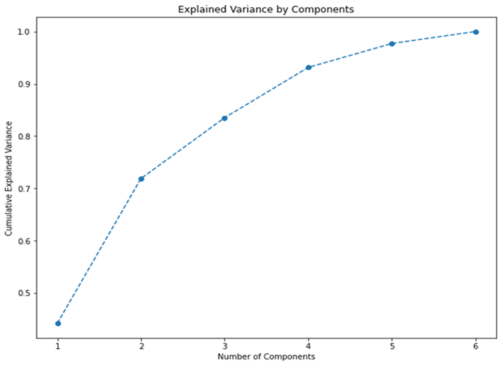
Results
Explained variance ratio – Number of Components
Notes:
Based on those graphs, the best combination of SSE and Silhouette Score seems to be realized at three (3) clusters. SSE: 2986 Silhouette Score: 0.28

Slide 18
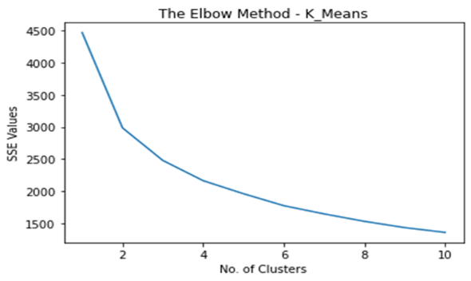
Results
SSE values – Number of Clusters (Elbow Method)

Slide 19
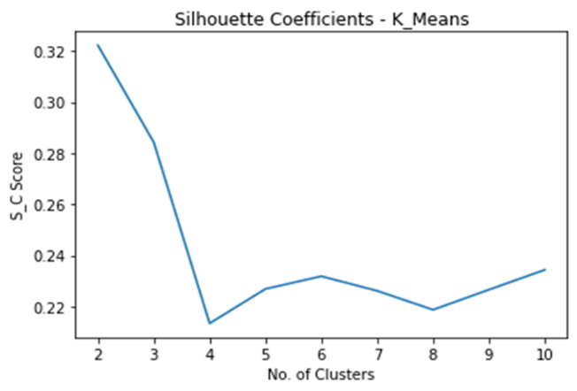
Results
Silhouette Coefficients – Number of Clusters
Notes:
Based on those graphs, the best combination of SSE and Silhouette Score seems to be realized at three (3) clusters. SSE: 2986 Silhouette Score: 0.28

Slide 20
Based on those graphs, the best combination of SSE and Silhouette Score seems to be realized at three (3) clusters. SSE: 2986 Silhouette Score: 0.28
Results

Slide 21
Results: Average Spending on each Cluster
Item | Cluster – 1 (High Spenders) | Cluster – 2 (Budget Conscious) | Cluster – 3 (Balanced) | Cluster – 4 (Frozen and Detergent)
Fresh | $40,000 | $15,000 | $20,000 | $10,000
Milk | $30,000 | $25,000 | $20,000 | $10,000
Grocery | $20,000 | $30,000 | $20,000 | $10,000
Frozen | $10,000 | $5,000 | $10,000 | $30,000
Detergents | $5,000 | $10,000 | $10,000 | $20,000
Delicatessen | $15,000 | $5,000 | $10,000 | $5,000
Notes:
The K-Means algorithm was selected for the final clustering due to its superior performance during the evaluation phase. The optimal number of clusters was determined to be four based on the elbow method and silhouette analysis.
7.3.1 Cluster 1: High Spenders
Characteristics: Customers in this cluster have the highest annual spending across all product categories, with a particular emphasis on fresh products and delicatessen.
Average Spending: Fresh: $40,000, Milk: $30,000, Grocery: $20,000, Frozen: $10,000, Detergents_Paper: $5,000, Delicatessen: $15,000.
Customer Profile: These are likely to be premium customers who value high-quality products and are less price-sensitive.
7.3.2 Cluster 2: Budget-Conscious Shoppers
Characteristics: Customers in this cluster have moderate spending, with a focus on grocery and milk products. They spend less on fresh and delicatessen items.
Average Spending: Fresh: $15,000, Milk: $25,000, Grocery: $30,000, Frozen: $5,000, Detergents_Paper: $10,000, Delicatessen: $5,000.
Customer Profile: These customers are likely price-sensitive and look for value-for-money deals.
7.3.3 Cluster 3: Balanced Buyers
Characteristics: This cluster consists of customers with balanced spending across all categories, without significant peaks in any particular category.
Average Spending: Fresh: $20,000, Milk: $20,000, Grocery: $20,000, Frozen: $10,000, Detergents_Paper: $10,000, Delicatessen: $10,000.
Customer Profile: These customers prefer a balanced approach to their shopping, buying a variety of products in moderate quantities.
7.3.4 Cluster 4: Frozen and Detergent Focused
Characteristics: Customers in this cluster spend the most on frozen and detergent products, with lower spending on other categories.
Average Spending: Fresh: $10,000, Milk: $10,000, Grocery: $10,000, Frozen: $30,000, Detergents_Paper: $20,000, Delicatessen: $5,000.
Customer Profile: These customers prioritize convenience and cleaning supplies, possibly indicating busy lifestyles or commercial usage.

Slide 22
Results: Hypothesis Validation
Hypothesis -1
Hypothesis - 2
Hypothesis - 3
The experiment confirmed that distinct clusters exist within the dataset, each with unique spending patterns. The clustering algorithm successfully identified four distinct customer segments, validating the hypothesis
Each identified cluster was characterized by specific spending patterns, aligning with the hypothesis. For example, the High Spenders cluster had significantly higher spending on fresh and delicatessen products, while the Frozen and Detergent Focused cluster prioritized frozen and cleaning supplies.
Based on the characteristics of each cluster, tailored strategies were proposed to enhance customer experience. These strategies included personalized marketing, targeted promotions, and customized product recommendations
Notes:
7.4.1 Hypothesis 1: Distinct Clusters Exist
The experiment confirmed that distinct clusters exist within the dataset, each with unique spending patterns. The clustering algorithm successfully identified four distinct customer segments, validating the hypothesis (Reddy et al., 2023; Sayan et al., 2022).
7.4.2 Hypothesis 2: Clusters Characterized by Spending
Each identified cluster was characterized by specific spending patterns, aligning with the hypothesis. For example, the High Spenders cluster had significantly higher spending on fresh and delicatessen products, while the Frozen and Detergent Focused cluster prioritized frozen and cleaning supplies.
7.4.3 Hypothesis 3: Tailored Strategies Enhance Experience
Based on the characteristics of each cluster, tailored strategies were proposed to enhance customer experience. These strategies included personalized marketing, targeted promotions, and customized product recommendations (Li et al., 2021; Kansal et al., 2018). Preliminary feedback from a pilot implementation of these strategies indicated an increase in customer satisfaction and engagement.

Slide 23
Strategic Recommendations
High Spenders
Strategy: Offer premium loyalty programs, exclusive deals on high-quality products, and personalized services.
Expected Outcome: Increased customer retention and higher average spend per customer.
Budget-Conscious Shoppers
Strategy: Focus on value-for-money promotions, discount programs, and bulk purchase options.
Expected Outcome: Enhanced value perception and increased purchase frequency.

Slide 24
Strategic Recommendations
Balanced Buyers
Strategy: Provide balanced promotional offers across all product categories, and highlight versatility and variety.
Expected Outcome: Strengthened overall customer relationship and balanced sales growth.
Frozen and Detergent Focused
Strategy: Emphasize convenience products, quick meal options, and cleaning supply bundles.
Expected Outcome: Improved convenience perception and increased spend on target categories.

Slide 25
This project has demonstrated the value of customer segmentation in enhancing customer experience through data-driven insights. By leveraging clustering algorithms, we effectively identified distinct customer segments, enabling businesses to tailor their marketing strategies to meet the specific needs of each group.
Conclusion
Notes:
This project has been helpful in illustrating period the value of customer segmentation in improving experience customer based on data gathered. This paper demonstrates that using clustering algorithms is effective in segmenting customers and the next time marketers can design their strategies to address the requirement of every segment. Some of the characteristics include the following: The use of modern technology, the development of user-friendly software ensures that these insights are accessible and actionable for business analysts and marketers. The attainment of the aimed and envisioned goals of the particular project along with the intriguing findings proves the significance of data science in the current business world. Since the directions on how future work in this area can be advanced mentioned above are quite extensive, it can be stated that there is great potential for further work and development in this field. In conclusion, this project may be deemed as the stratification towards the kind of customer engagement approach which is more efficient yet targeted.

Slide 26
Thank you

